Slide 1
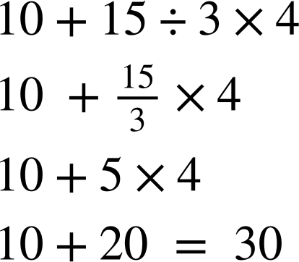
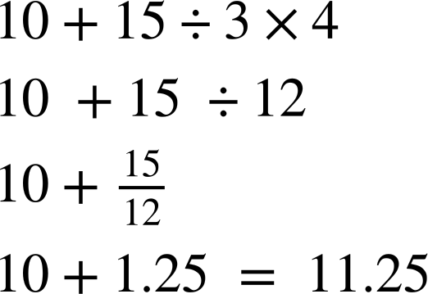
Priority of operations with positive integers
Task A: Multiplication, division, addition and subtraction
Work out the answers to the following. Ensure to show all your working out.
12 + 6 × 2
100 − 20 ÷ 5
c) 3 × 10 − 24 ÷ 8
2) Sam and Sofia do the same calculation differently. Whos is correct? Explain what they should have done differently.
Sam
Sofia
3) Fill in the gaps with +, −, ÷ and × so that the calculations are correct.
a) 4 ⬚ 5 ⬚ 6 ⬚ 7 = 12
b) 4 ⬚ 5 ⬚ 6 ⬚ 7 = 8
c) 4 ⬚ 5 ⬚ 6 ⬚ 7 = 62
d) 4 ⬚ 5 ⬚ 6 ⬚ 7 = 7
e) 4 ⬚ 5 ⬚ 6 ⬚ 7 = 21
4) Fill in the gaps with +, −, ÷ and × so that the calculations are correct.
a) 10 ⬚ 2 ⬚ 2 ⬚ 3 = 8
b) 10 ⬚ 2 ⬚ 15 ⬚ 3 = 10
c) 10 ⬚ 2 ⬚ 10 ⬚ 2 ⬚ 2 ⬚ 3 = 21

Slide 2
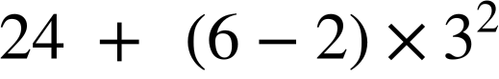
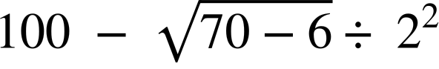
Priority of operations with positive integers
Task B: Brackets, roots and exponents
Work out the answers to the following. Ensure to show your working out.
a)
b)
2) Fill in the gaps with +, −, ÷, × and brackets so that the calculations are correct. You can use more than one pair of brackets.
a) 4 5 6 7 = 117
b) 4 5 6 7 = 308
c) 4 5 6 7 = 69
d) 4 5 6 7 = 1
3) Use exactly four 4s, together with any of the operations ×, ÷, +, √, −, exponents (can be any value) and/or brackets to write calculations giving answers of: 1, then 2, then 3… up to 20. As an example, 8 has been done for you.
1 =
2 =
3 =
4 =
5 =
6 =
7 =
8 =
9 =
10 =
11 =
12 =
13 =
14 =
15 =
16 =
17 =
18 =
19 =
20 =
Mathematics in Education and Industry
v2.1

